Slide 1
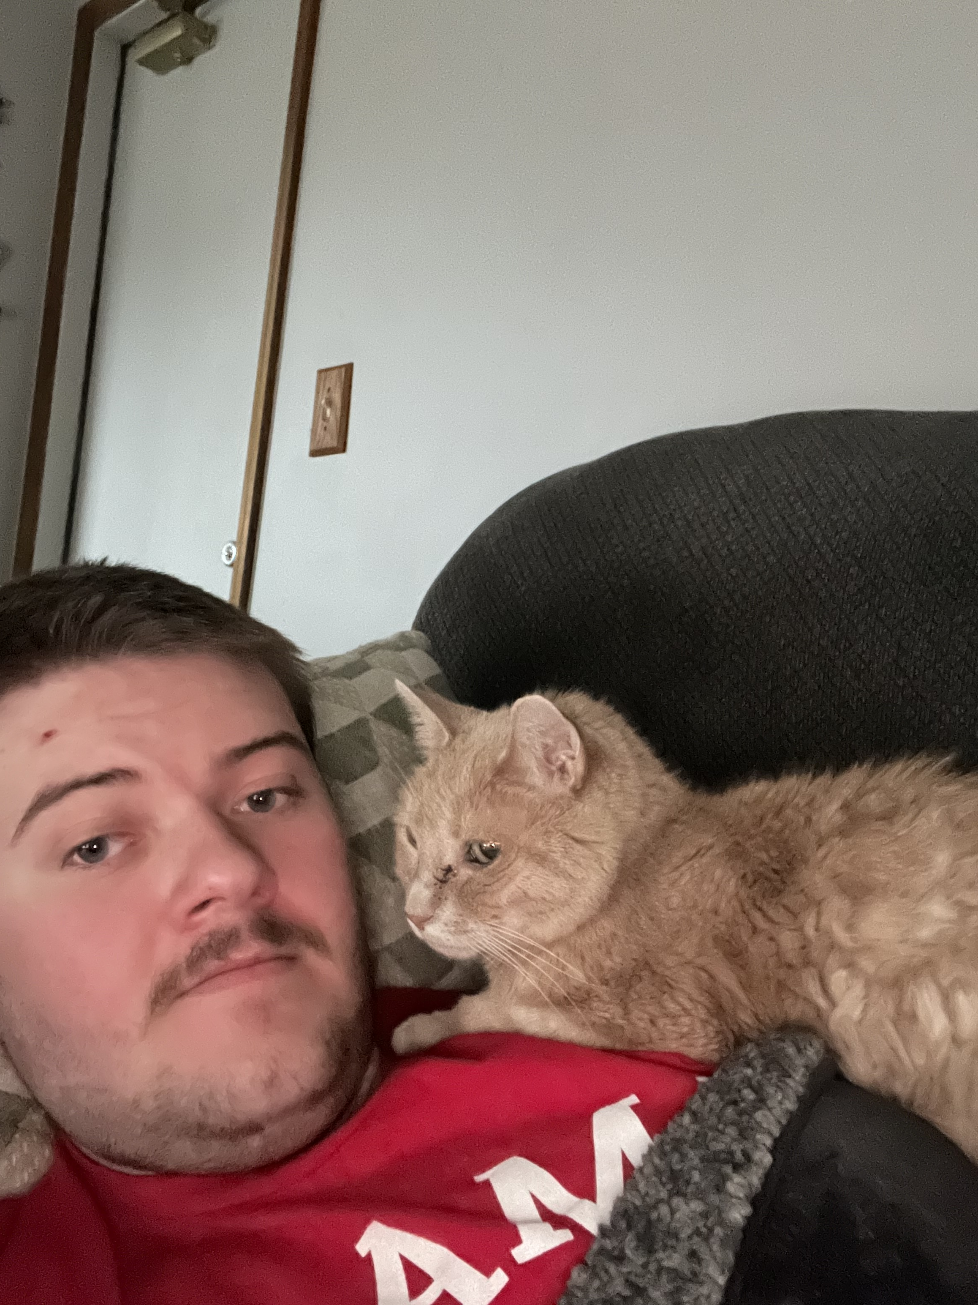
Andrew Gartner
Major: Information Technology
Class Rank: Sophomore
Hometown: Fairfield, Ohio
My favorite Hobbies:
Watching Survivor
Playing Video Games
Walking my Puppy
Facts about me:
I’m 6’6 tall
I have 3 siblings
Used to have 5 pets in my household

