Slide 1
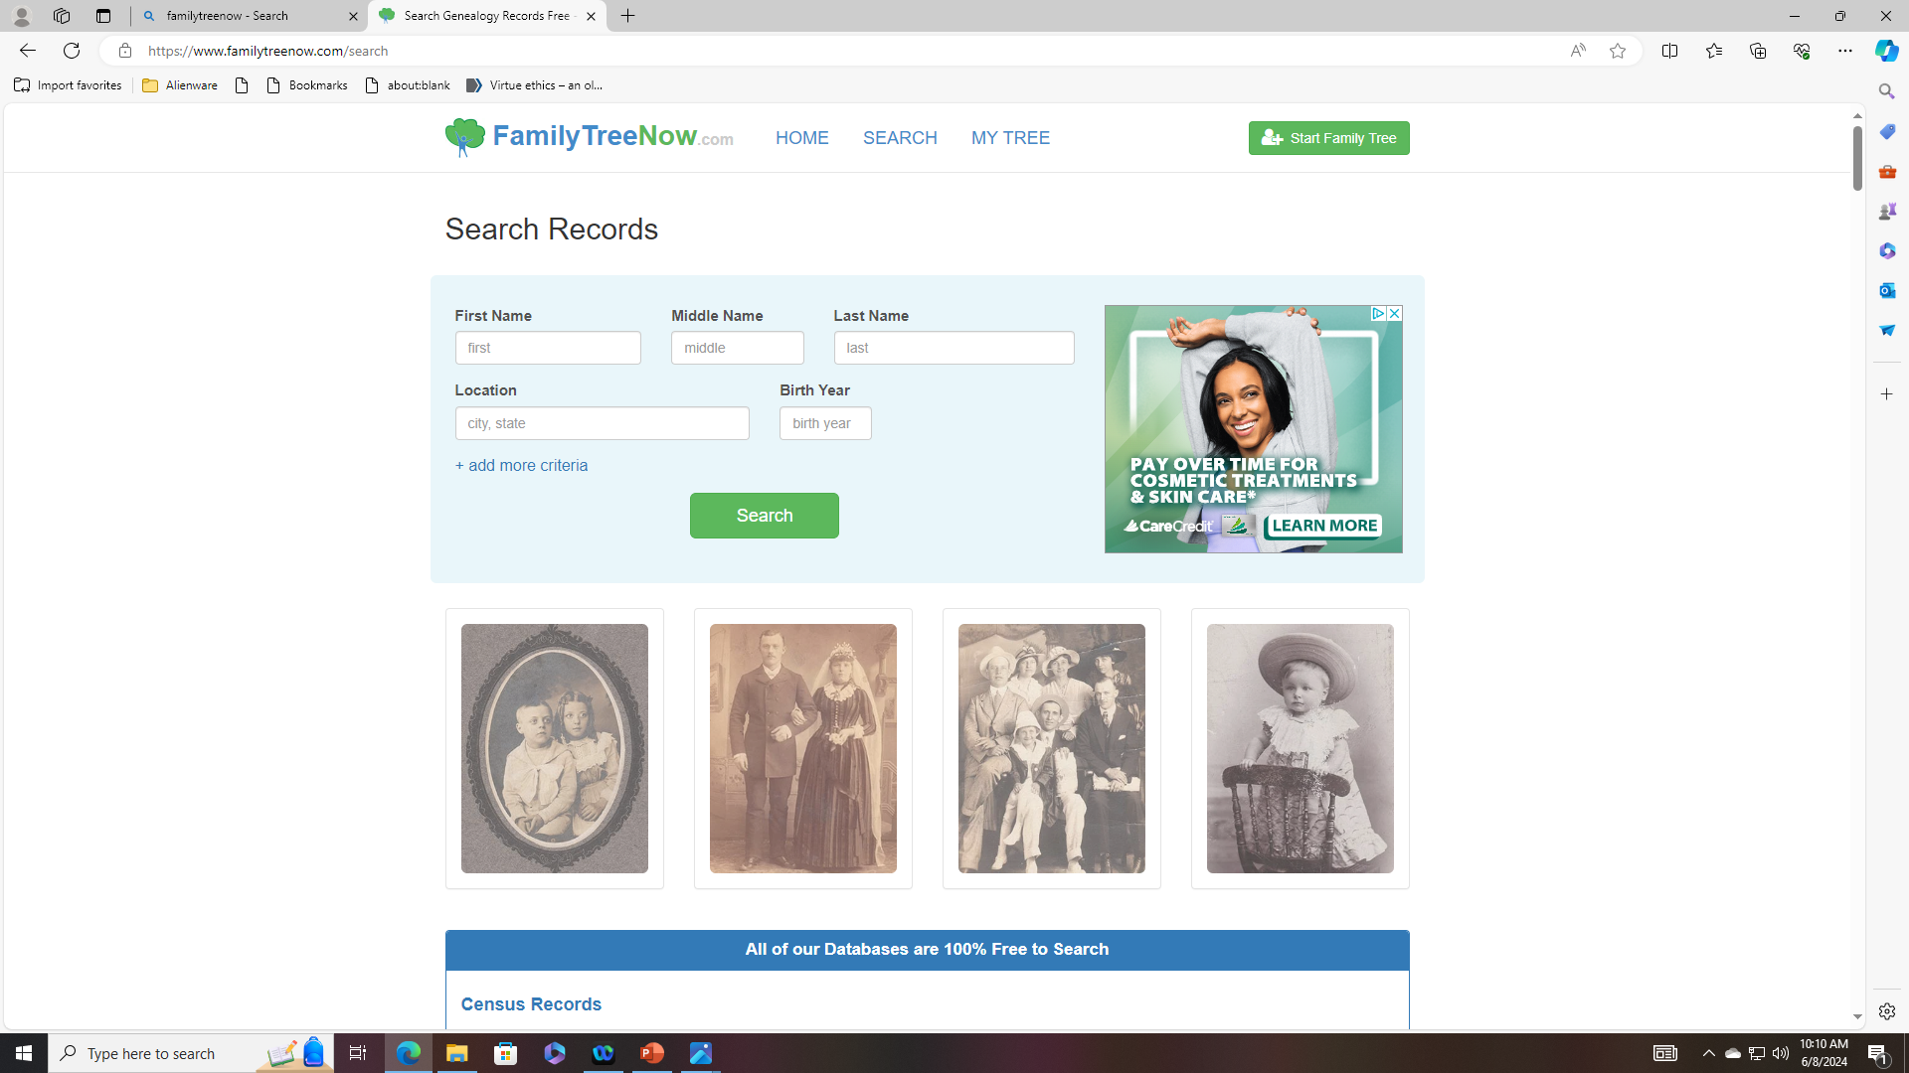
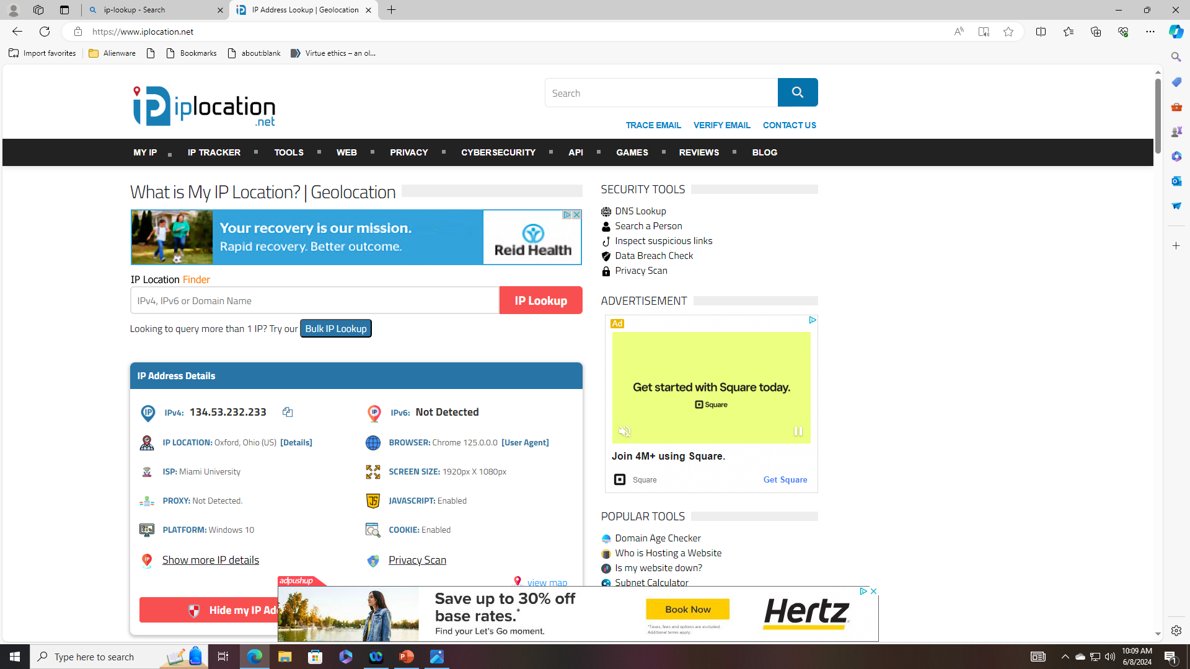
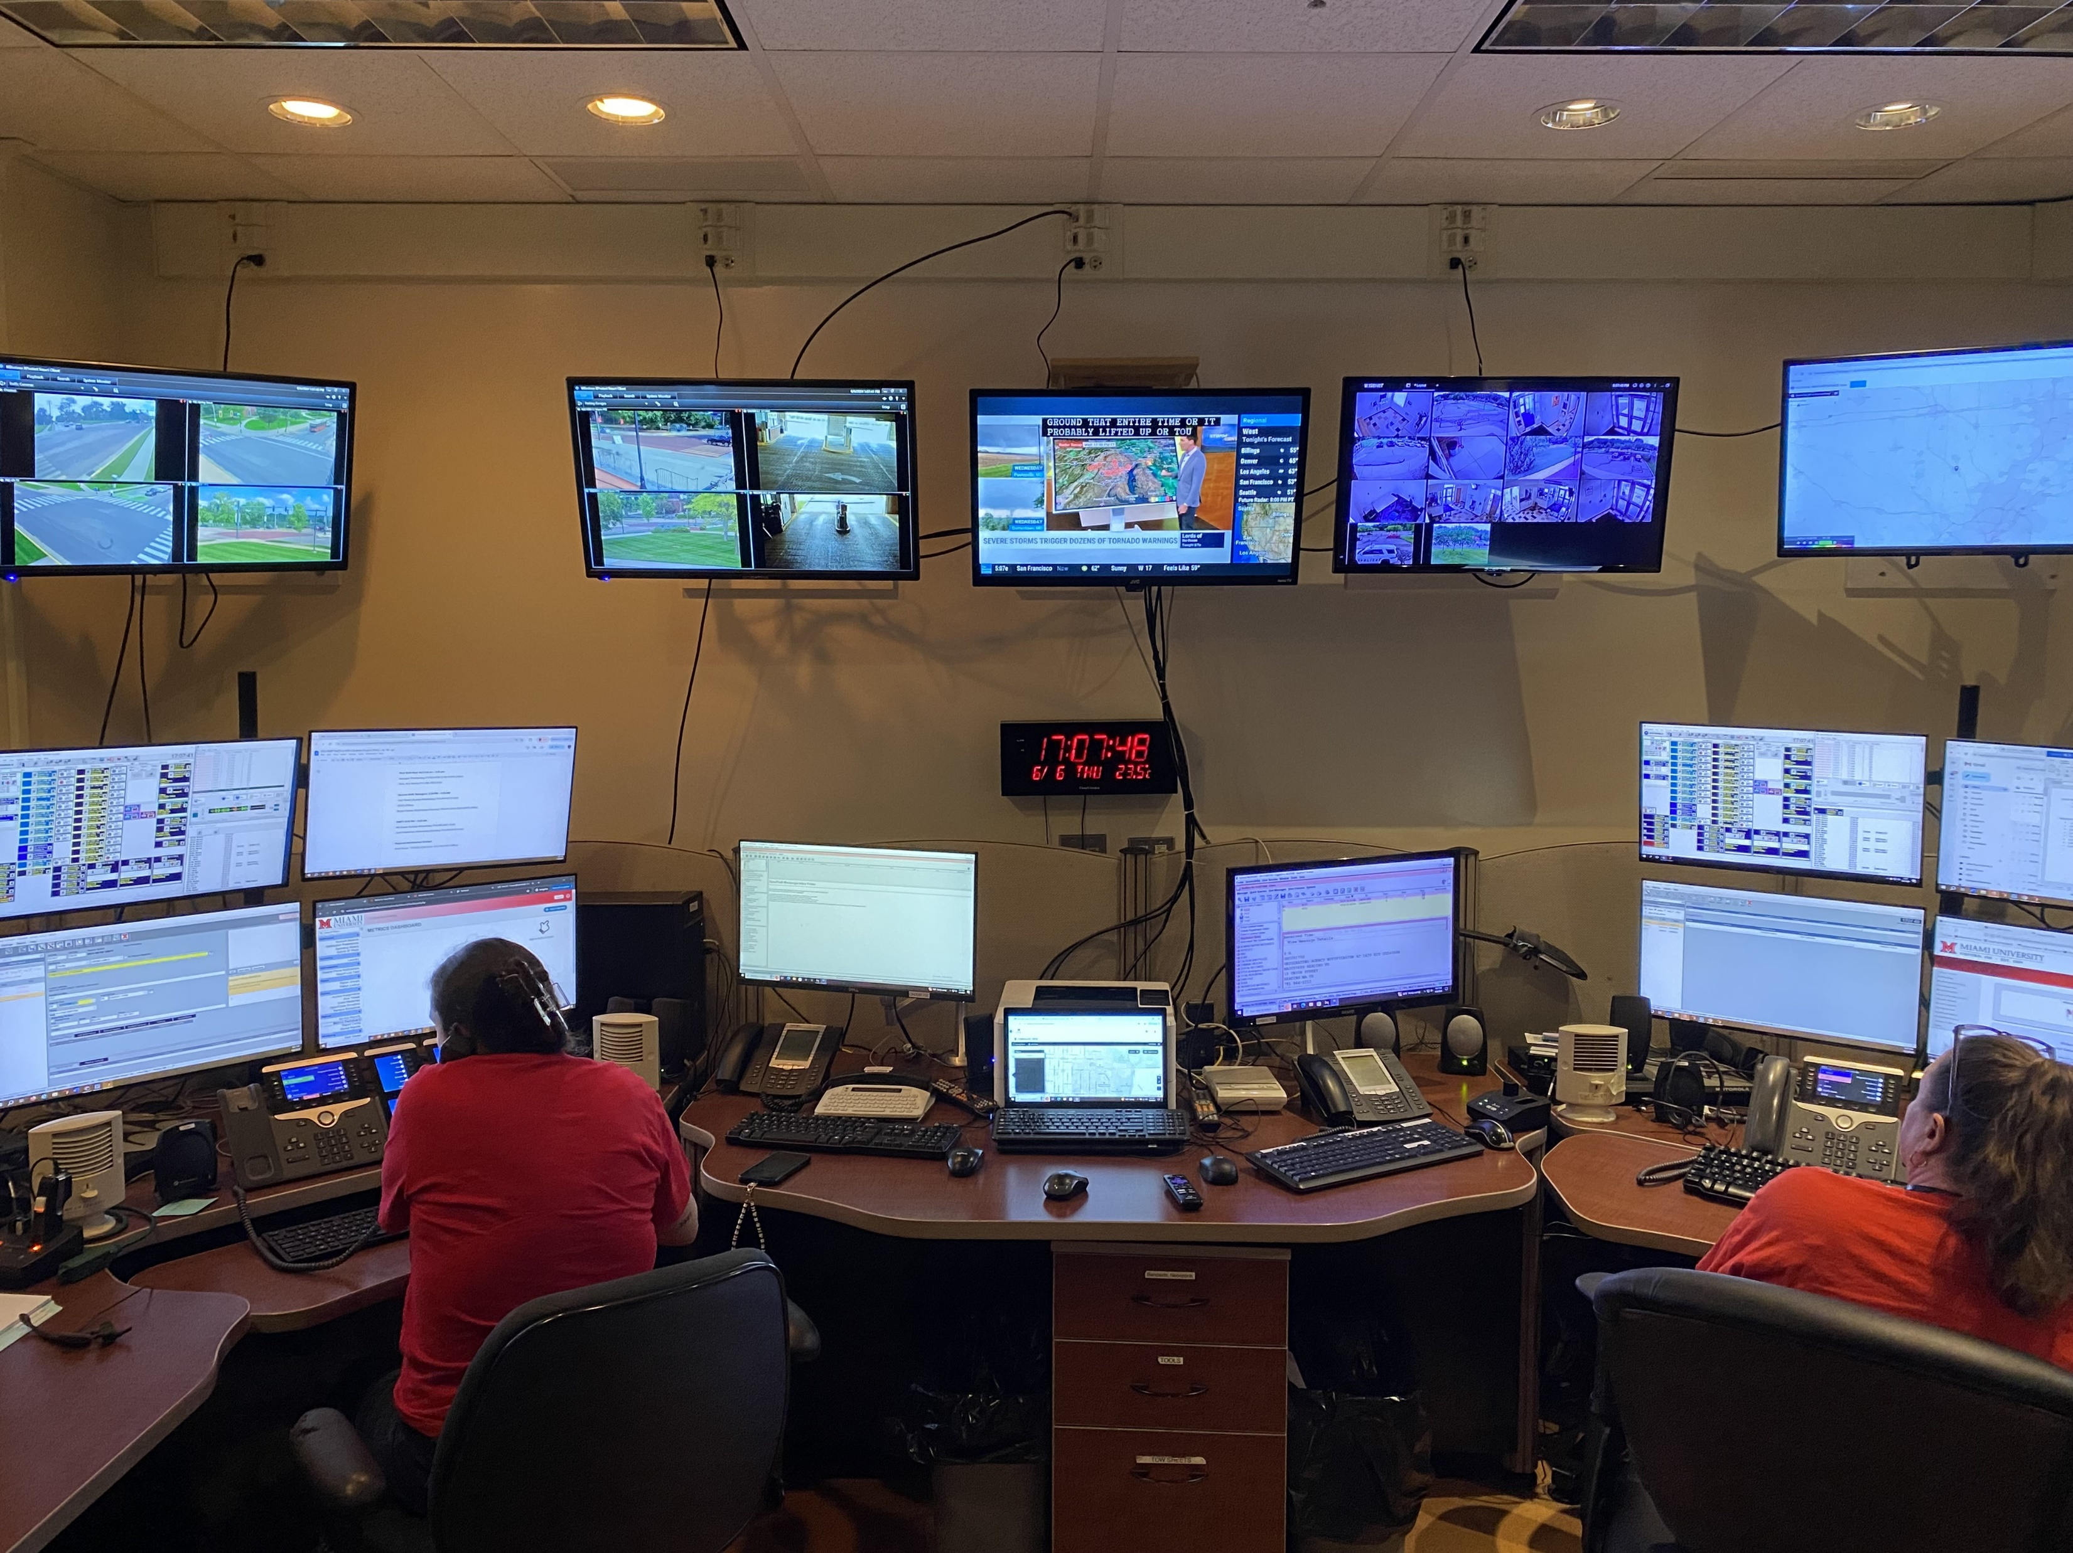



Every breath you take,
Every step you make,
I’ll be watching you
Familytreenow.com…Try it!
Iplocation.net…Always tracking
Amazon
Look for cameras when you’re out..
You’re being monitored and recorded
Social media accounts
Knowing how much personal data is available online does worry me. Amazon, social media, etc.. Databases. How secure are they? How will it be used to harm me?
The wealth of information on the web is at my fingertips so my search history is a peek inside my mind. Google seems to know me better than I know myself.
My privacy has been violated before by fraudulent purchases, identity theft, targeted online ads. All it took was one credit card theft to turn my life upside down for a bit.
A small online footprint is one method I used to protect my privacy. The less I share the less that is easily obtainable. I don’t need to feel “connected”.
HIPPA Laws are a great tool to protect health records but that law is only as strong as the ethics of the people that have data and follow the laws.
As technology advances more personal data will be “stored” online opening so many opportunities for privacy violations
Keith Hibbard

