Slide 1
NATIONAL AND LOCAL POLICING CRISIS!!
There is currently a very serious police recruitment and retention crisis in America, at a time when law enforcement is needed more than ever (Associated Press, 2023)(Charalambous, 2023)
On October 17th, 2023, the U.S. Justice Department released a new publication⁴ aimed at addressing this problem, stating:
  “The Justice Department knows that hiring and holding onto a highly qualified, committed, and diverse cadre of policing professionals is critical to public safety and police-community trust, and we are committed to working with our partners to address this crisis.” (DOJ, 2023)
  Associated Press, “The U.S. is Experiencing a Police Hiring Crisis” https://www.nbcnews.com/news/us-news/us-experiencing-police-hiring-crisis-rcna103600
  ABC News, “’Vicious Cycle’: Inside the Police Recruiting Crunch with Resignations on the Rise” https://abcnews.go.com/US/police-departments-face-vicious-cycle-challenges-retaining-recruiting/story?id=98363458
  International Association of Chiefs of Police (IACP), “The State of Recruitment: A Crisis for Law Enforcement” https://www.theiacp.org/sites/default/files/239416_IACP_RecruitmentBR_HR_0.pdf
  U.S. Justice Department, “Recruitment and Retention for the Modern Law Enforcement Agency Office of Public Affairs | Justice Department Releases Report on Recommendations for Law Enforcement Agencies Facing Recruitment and Retention Challenges | United States Department of Justice

Slide 2
SOLUTIONS
The Justice Department’s report provides recommendations to help improve this crisis (DOJ, 2023):
  Reconsidering officer eligibility requirements to better reflect modern police work
  Modernizing and accelerating the hiring process
  Investing in officer health, safety, and wellbeing
  Working with community leaders to target recruitment efforts toward diverse candidates and potential recruits who might otherwise not consider law enforcement as a career

Slide 3
HOW TO SOLVE THE SHORTAGE AT MUPD
Pay is directly related to both recruitment AND retention
If MUPD is to thrive, we must remain competitive with surrounding agencies
  The consequences of not being competitive include:
    A lack of eligible and high-quality candidates willing to join MUPD
    The risk of current high-performing members of MUPD leaving to work elsewhere
Fact: MUPD is NOT keeping up with its peers, as the data on the next several slides will show

Slide 4
HOW MIAMI UNIVERSITY COMPARES
MUPD starting officer pay is $63,128
  This is $2,025.67 LESS than the average Butler County officer starting pay
  This is $10,582 LESS than the highest starting officer pay in Butler County (West Chester)
  This is $5,242 MORE than the lowest starting officer pay in Butler County (Fairfield Township)
MUPD maximum officer pay is $78,777
  This is $10,142.65 LESS than the average Butler County officer maximum pay
  This is $19,150 LESS than the maximum officer pay in Butler County (West Chester)
  This is the LOWEST maximum officer pay in Butler County
The MUPD Chief’s pay is $154,246.31 (including $2000 stipend)
  This is $20,228.68 MORE than the average Butler County Chief pay
  This is $43,518 MORE than the lowest Butler County Chief pay
  This is the second highest Chief pay in Butler County

Slide 5
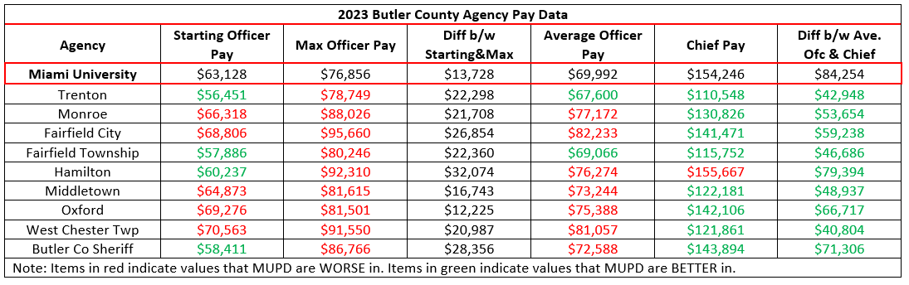
Pay – Comparison to Peers (2023)

Slide 6
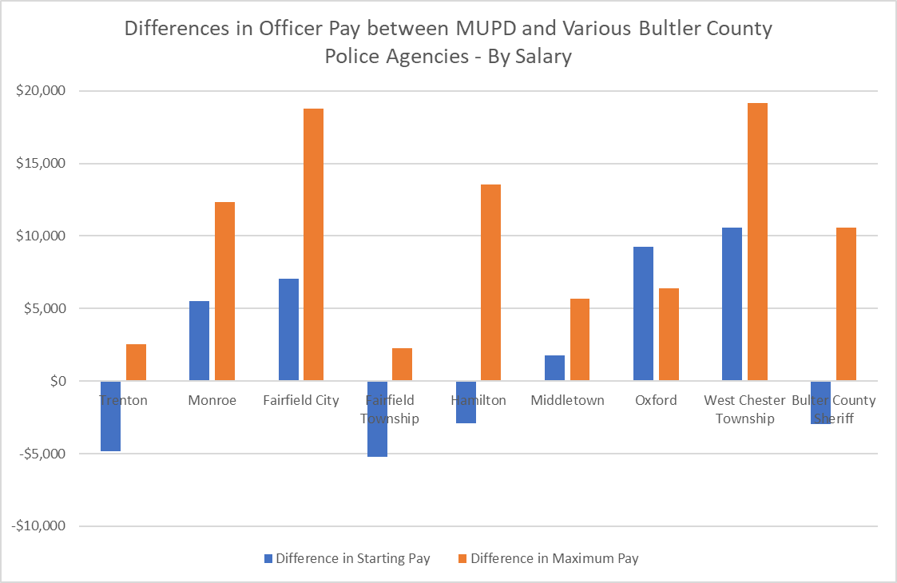
Pay – Comparison to Butler County Agencies
Every other agency in Butler County has a higher maximum officer pay than MUPD
Five Butler County agencies have a higher starting officer pay than MUPD

Slide 7
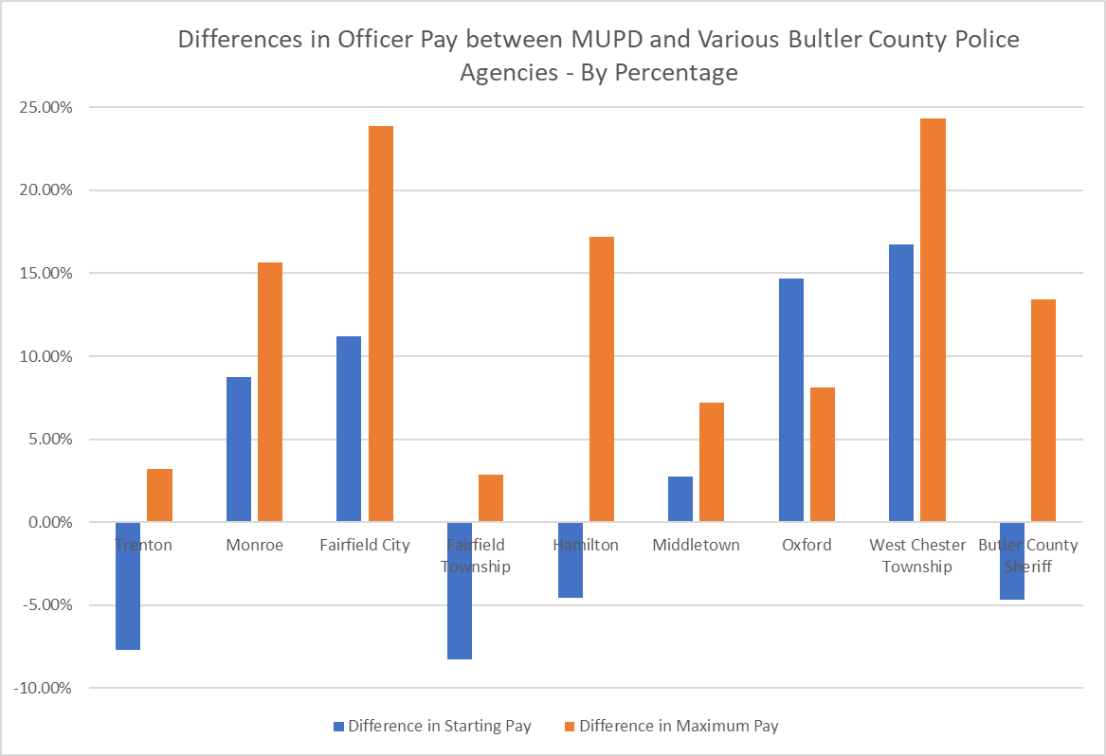
Pay – Comparison to Butler County Agencies
Every other agency in Butler County has a higher maximum officer pay than MUPD
Five Butler County agencies have a higher starting officer pay than MUPD

Slide 8
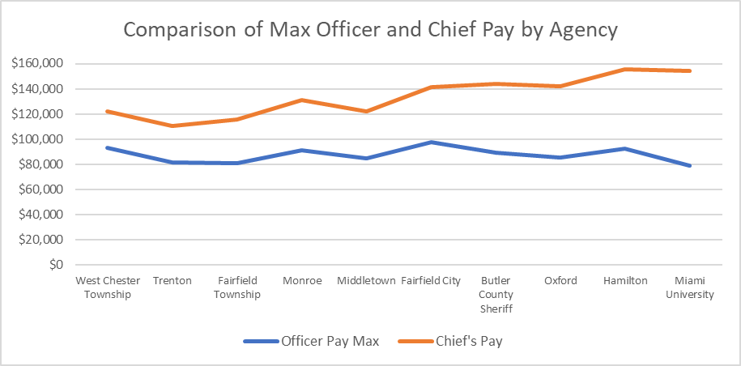
Pay - Disparity
MUPD has the HIGHEST disparity between maximum officer and chief pay in Butler County
This negatively affects morale, recruitment and retention
Note: The more close in distance the blue and orange lines are, the more pay equality exists between officer and chief. The further apart the blue and orange lines are, the greater the difference between officer and chief pay (i.e. “Boss makes a dollar, I make a dime…”)

Slide 9
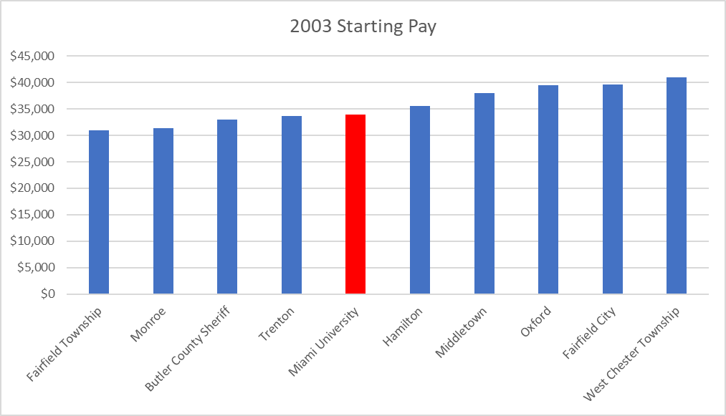
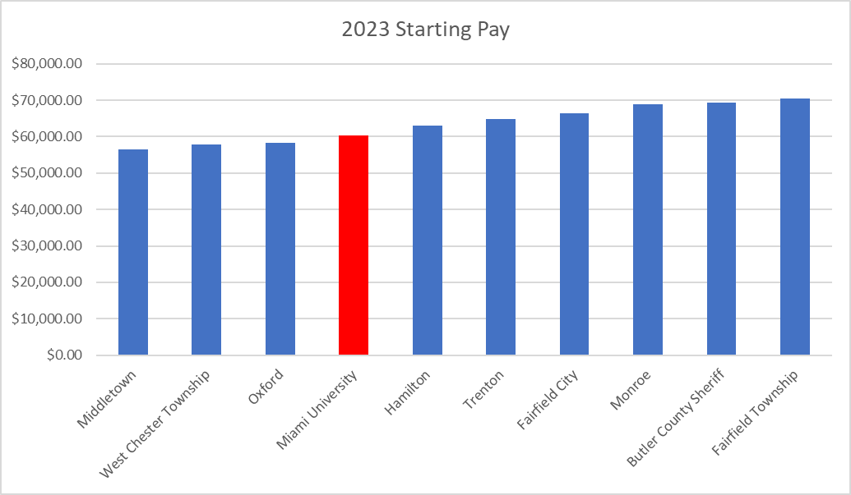
Pay – Historical Comparison: 2003 vs 2023 Starting Pay
In 2003, Miami ranked 6th out of 10 in starting pay at $33,883
In 2023, Miami ranked 7th out of 10 in starting pay at $60,236

Slide 10
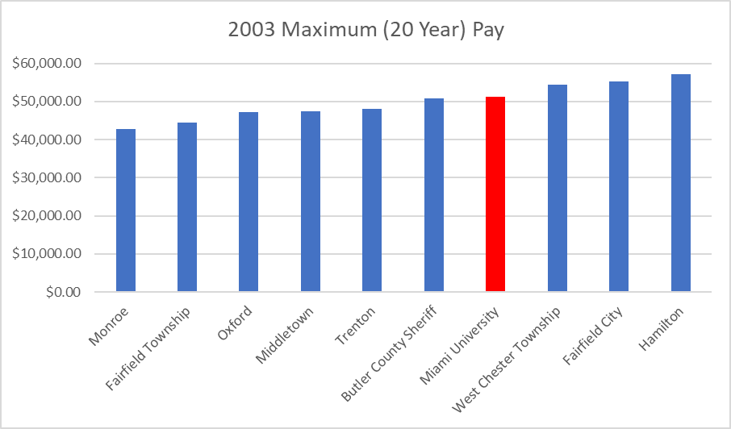
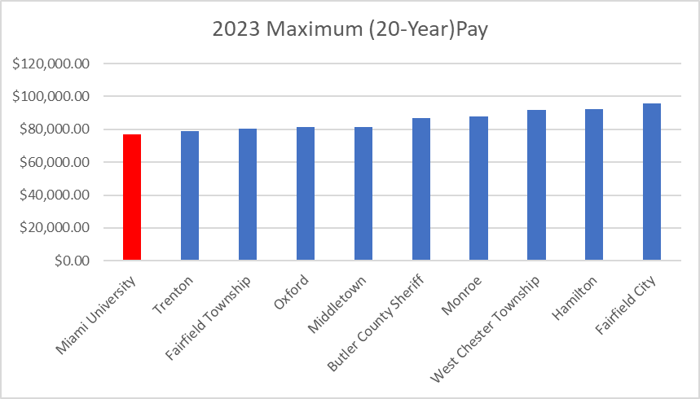
Pay – Historical Comparison: 2003 vs 2023 Maximum Pay
In 2003, Miami ranked 4th^{th} out of 10 in maximum pay at $51,155
In 2023, Miami ranked 10th out of 10 in maximum pay at $76,856

Slide 11
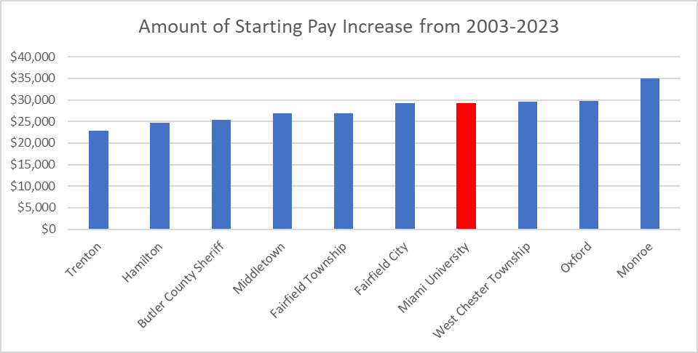
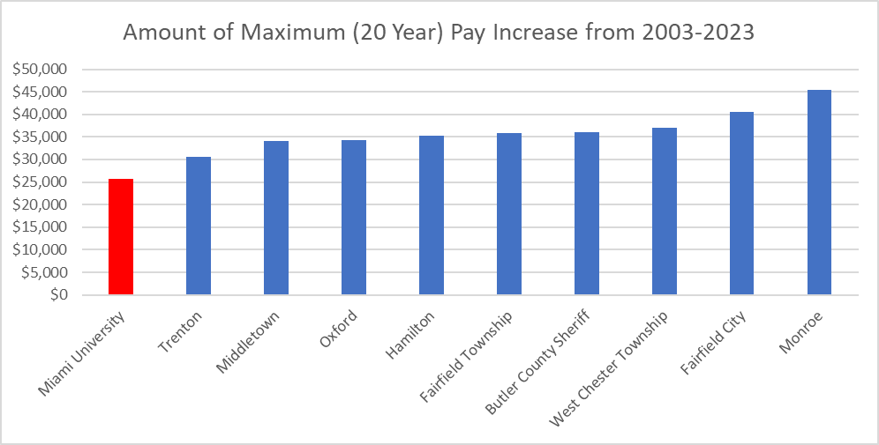
Pay – Historical Comparison: Increases from 2023
In order to stay competitive and keep up with inflation-related cost-of-living increases, wages must also increase
These two graphs show the amount that each agency’s starting and maximum pay increased over a 20-year period, from 2003 to 2023
Miami ranks 4th out of 10 for amount of starting pay increase from 2003-2023
Miami ranks 10th out 10 for amount of maximum pay increase from 2003-2023

Slide 12
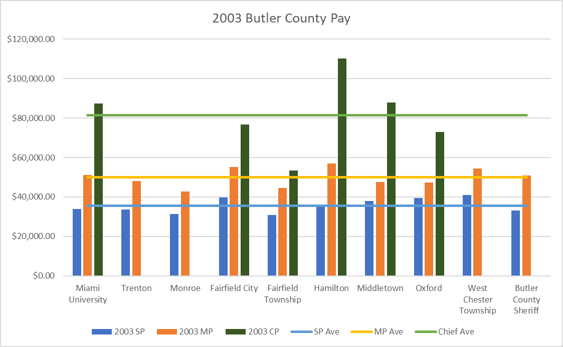
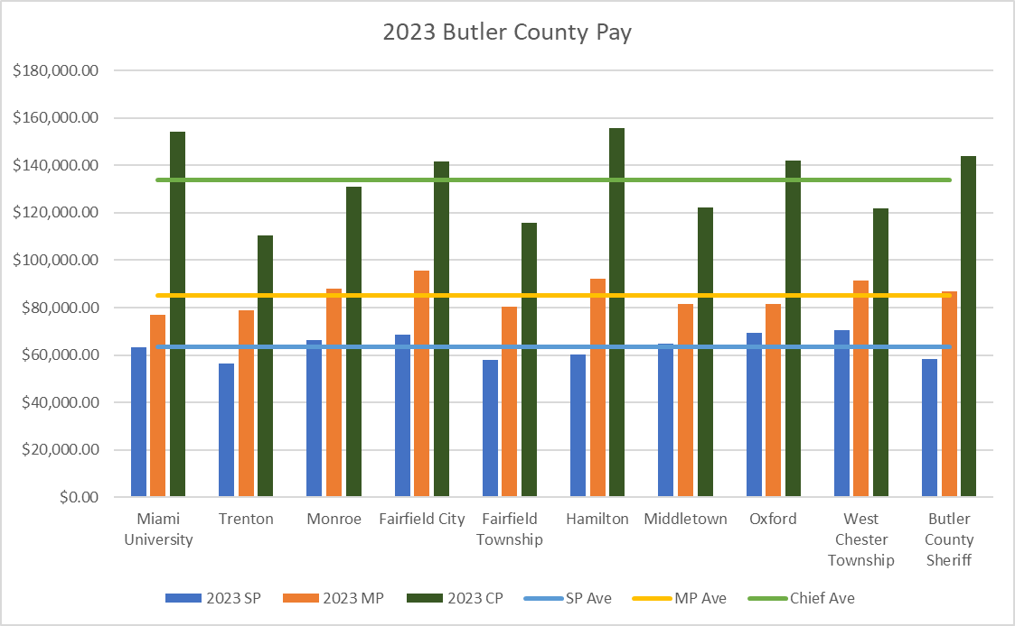
Pay – Historical Comparison & Trends

Slide 13

“Miami University’s top priority is always the safety of our students and community.”
(Miami University, 2024)
IT’S GONNA TAKE MORE THAN EMPTY WORDS TO SOLVE THE POLICE STAFFING SHORTAGE

Slide 14
Works Cited
Associated Press. “The U.S. Is Experiencing a Police Hiring Crisis.” NBCNews.Com, NBCUniversal News Group, 6 Sept. 2023, www.nbcnews.com/news/us-news/us- experiencing-police-hiring-crisis-rcna103600.
Charalambous, Peter. “‘Vicious Cycle’: Inside the Police Recruiting Crunch with Resignations on the Rise.” ABC News, ABC News Network, 6 Apr. 2023, abcnews.go.com/US/police-departments-face-vicious-cycle-challenges-retaining-recruiting/story?id=98363458.
Ohio SERB. “State Employment Relations Board.” Ohio Collective Bargaining Agreements, 19 Apr. 2024, serb.ohio.gov/.
International Association of Chiefs of Police. “The State of Recruitment: A Crisis for Law Enforcement.” IACP Recruitment Brochure, 12 Mar. 2020, www.theiacp.org/sites/default/files/239416_IACP_RecruitmentBR_HR_0.pdf.
Miami University. “Reaffirming Our Commitment to Safety in Our Community.” Miami University, 2 Jan. 2024, miamioh.edu/news/2024/01/reaffirming-our-commitment-to- safety-in-our-community.html.
US Department of Justice. “Justice Department Releases Report on Recommendations for Law Enforcement Agencies Facing Recruitment and Retention Challenges.” Office of Public Affairs | Justice Department Releases Report on Recommendations for Law Enforcement Agencies Facing Recruitment and Retention Challenges | United States Department of Justice, 17 Oct. 2023, www.justice.gov/opa/pr/justice-department-releases-report-recommendations-law-enforcement-agencies-facing.

